Slide 1

Status of IPv6 Implementation in Canadian Higher Education
Who is doing it?
How is it getting it done?

Slide 2




Introductions
Eric van Wiltenburg, University of Victoria
Andree Toonk, University of British Columbia / BCNET
Luc Roy, Laurentian University
Steve Benoit, Georgian College
John Sherwood, Alindale / ACORN-NS
Eriks Rugelis, York University
Notes:
Driving the Trans Canada Highway from west to east…
Eric van Wiltenburg: Manager, Information Security Office
…is the Manager of the Information Security Office at the University of Victoria (UVic). He is an advocate for information security at UVic and has similar responsibilities as the BCNET Security Officer. He also participates in BCNET Network Security Working Group, The Canadian University Council of CIO's (CUCCIO), Research and Education Networking Information Sharing and Analysis Centre (REN-ISAC), and Educause.
Andree Toonk: Network Architect
Andree Toonk is employed by the University of British Columbia as a Network Architect for BCNET. His primary focus is on the BCNET network architecture and network management tools. Before joining UBC Andree worked in The Netherlands at The Amsterdam Internet Exchange (AMS-IX) and at SARA's High Performance Networking group. At SARA he was primarily working on several IPv6 implementation projects and SURFnet, the Dutch national research network. Andree received his M.Sc. degree in System and Network Engineering from the University of Amsterdam. Andree is the author of open source and communities tools such as BGPmon.net and the Perl TL1-Toolkit
Luc Roy: CIO
Previously… Northern Telecom X.25 network designer; 1992 Wellfleet Communications; 1994 moved to Silicon Valley and Bay Networks; Nortel Networks, Director Product Management and Product Marketing for Accelar 8600 and Centillion; Extreme Networks; Greenfield Networks (now Cisco); Chantry Networks (now Enterasys)
Steve Benoit: Manager, Infrastructure & Security
Apologetically "Hello my name is Steve and I'm an IPv6 newbie." Steve's current role is Manager, Infrastructure and Security for a mid-sized Ontario community college where, for over 20 years, he has helped to grow the network from 50 PC XT computers, terminals, and a VAX system to over 9,000 wired connections at 10 sites. Networking experiences have included DECNET, ARCnet, Novell and of course many vendors versions of IPv4.
John Sherwood: Alindale Consultants/ ACORN-NS
John has been involved in national networking for many years, including various roles in CA*net, ACORN-NS, and CANARIE. He and Marc Blanchet set up the earliest IPv6 Canadian network through CANARIE in 1999. He recently retired from Dalhousie University and now works only on interesting projects (shc as technical coordinator at ACORN-NS) through his company Alindale Consultants.
Eriks Rugelis: Lead Network Architect
Previously Manager Network Development at iStar Internet, co-owner of Netidea Inc. consultancy, has worked on development of broadband ISP services and support infrastructure for Rogers.

Slide 3
Why IP version 6?
Imminent exhaustion of public IPv4 address space vs. continuing growth in demand for addresses… limits to growth of the IPv4 Internet (IANA IPv4 exhausted Feb. 2011)
Services, content, users which have on IPv6
NAT impacts on end-to-end connectivity
IPv4 address space arbitrage
IPv4 hijacking .

Slide 4
What is holding us back?
Infrastructure readiness
network routers
access network switches (1st hop security)
WiFi access networks
security monitoring and enforcement tools
network provisioning systems
network monitoring systems
diagnostic tools
quality of IPv6 implementations .

Slide 5
What is holding us back?
Decisions on standards and policies
IPv6 address plan development / management
Selecting PI vs PD address space (fear of prefix re-numbering)
Privacy addresses vs. operational procedures
NAT64 vs dual-stack
Dynamic DNS registration
SLAAC vs DHCPv6 .

Slide 6
What is holding us back?
People and procedures
training of IT staff in basic technology (what does ‘normal’ look like now?)
provisioning procedures
diagnostic procedures in a dual-stack and/or NAT64 world?
implementation-specific behaviours (pick your OS)
Inventory of applications. Per-application testing and remediation .

Slide 7
What is holding us back?
Infosec policies and procedures
network and host security profiles
new attack vectors .

Slide 8
What are you doing about it?
How aware of IPv6 is your organisation as a present or future concern?
How is your organization approaching deployment of IPv6?
Y2K death-march?
Gradual implementation?
What do you see as the most potent drivers for IPv6 readiness in your organization?
What was the easiest thing to get right?
What was the hardest thing to get right? .
Notes:
Awareness: network staff? General IT staff? CIO? Senior administration?

Slide 9
UBC

Slide 10
IPv6 at BCNET - Status
Running IPv6 for several years, production grade since ~2 years
Provider independent address space
IPv6 transit was mandatory in latest transit RFP
Multiple IPv6 upstream providers
IPv6 Peering at Seattle Internet Exchange
Public services such as BCNET wiki and www.bc.net available over IPv6
Participating in world IPv6 day
IPv6 awareness day
IPv6 community lab

Slide 11
IPv6 at BCNET - Easy
IPv6 (core) Routing
Modern routers have full IPv6 support for routing
ISIS, OSPFv3, BGP
ACL’s
Configuration
Similar as IPv4
IPv6 on our servers (although some challenges)

Slide 12
IPv6 at BCNET - Challenges
Traffic accounting
distinguishing IPv6 from IPv4 can be challenging.
Buying IPv6 transit
Little choice of dual stack capable service providers
IPv6 network management software
IPAM (IP address management)
IPv6 address is 128 bits
Perl (> 64 bits numbers requires Math::BigInt)
PHP similar problems
MySQL (bigint 64 bits) How to store an IPv6 address?

Slide 13
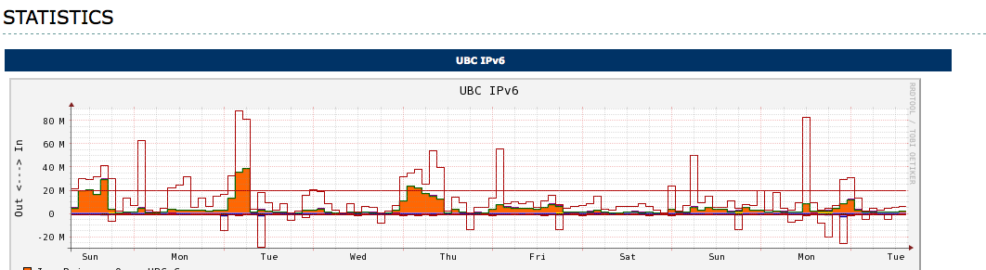
IPv6 at UBC – Status
Started deploying IPv6 in 2010
Core and border are IPv6 ready
2 production IPv6 subnets (debian.org)
Participating in world IPv6 day (www.ubc.ca over IPv6)

Slide 14
IPv6 at UBC – Challenges
Limited rollout…
Lack of IPv6 support in firewalls
Cisco PIX firewalls IPv6 in software, poor performance
Lack of IPv6 support in load balancers
Limits IPv6 rollout in data centre
IPv6 capable traffic shapers
IPv6 network management software
(Network management centre relies heavily on provisioning and monitoring tools)
Support & Security concerns
What are the implications of enabling IPv6?

Slide 15
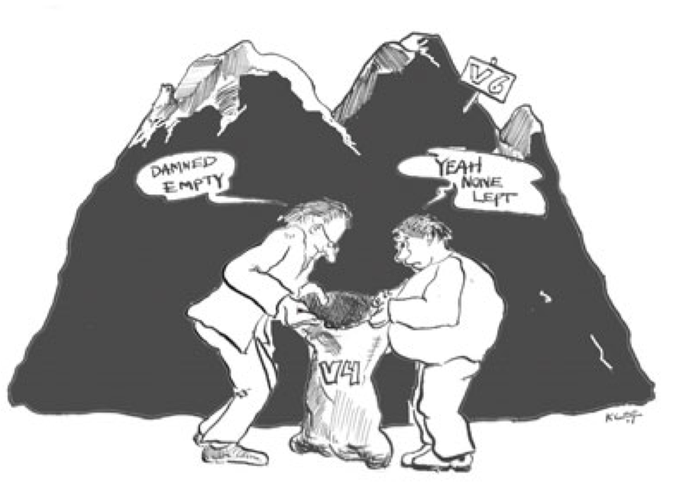
Conclusion
Deploying IPv6 in the core is relatively easy.
Complexity increases towards the edge
Network management tools typically require a lot of work
The sooner you start the better!

Slide 16
University of Victoria

Slide 17
University of Victoria
Core network infrastructure – Mostly “easy”
Devices and tools – Lack of feature parity
McAfee IPS
PacketShaper
F5 Load Balancers
Cisco ASA
Cisco FWSM
Cisco mid-range multilayer switches
Netflow anomaly detection
Custom-built management tools (VLAN/IP/DNS/ACLs/AuditTrail)
Notes:
McAfee Intrushield I-4000 IPS
- Letter of compliance, indicates compliance to numerous IPv6 RFCs and to US DoD IPv6 Standard Profiles for IPv6 Capable Products Version 2
- Fairly comprehensive support for IPv6, close to IPv4 feature parity for examining traffic
- CIDR-based virtual IPS not supported (which we use)
- DoS/DDoS detection not supported
PacketShaper -
- no real IPv6 support
- Takes IPv6 and puts it in a bucket so you can manage all IPv6 as one collective bucket, but not for individual protocols and applicat
ions like in IPv4
- BitTorrent clients try to be smart and use IPv6 when available as that traffic is not often shaped
- NOTE: Have also seen reports of malware that uses IPv6 back-channels to avoid detection
F5 BigIP 6500 Load Balancers
- IPv6 supported ($$$ in v9, free in v10).
- To put www.uvic.ca on IPv6 first requires work on load balancers
Cisco ASA
- limited native IPv6 support
- AnyConnect client appears to do IPv6 well
- IPSec client has no support, and appears no support planned
Cisco FWSM
- some IPv6 support
- if using failover (ie redundant pair, and who isn't??), IPv6 not supported
- rumours of support only in FWSMs yet-to-be-released successor
Netflow
- Doing netflow-based badness detection using flow-tools + custom scripts
VERY valuable detection method at the moment
- No netflow v9 support (req for IPv6)
- need to convert to other netflow tools that support Netflow v9
Internal management tools
- ACL manager syntax checker is IPv4-only so far
- IP and DNS management tools only IPv4
- lots of internal tool upgrading to do

Slide 18
Laurentian University

Slide 19
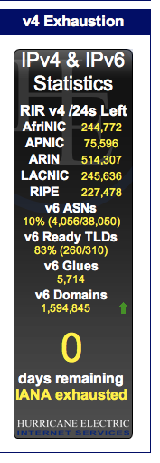
IPv6 at Laurentian U.
Why?
No more IPv4 – Ah.
Internet moving to IPv6 – Dah!
International students with IPv6 only cannot see LU website – Doh!
www.potaroo.net

Slide 20
IPv6 at Laurentian U.
Status (March 2011):
Full IPv6 peering with primary ISP
Website – IPv6
Webmail – IPv6
On deck:
Email server – need upgrade to spam filter
Firewall – need to extend firewall rules to IPv6
Internal network – need to cleanup addressing scheme
DNS – non issue with dual stack
Addressing – SLAAC for now; IPAM later
R
R
R

Slide 21
IPv6 at Laurentian U.
Challenges:
Education!!!!!!!!
More downtime than expected (mostly appliances)
Poor vendor support
Best practices (e.g. policing, transition from SLAAC to DHCPv6 for IP governance, …).
Follow us: http://blog.laurentian.ca/ipv6/

Slide 22
Georgian College

Slide 23
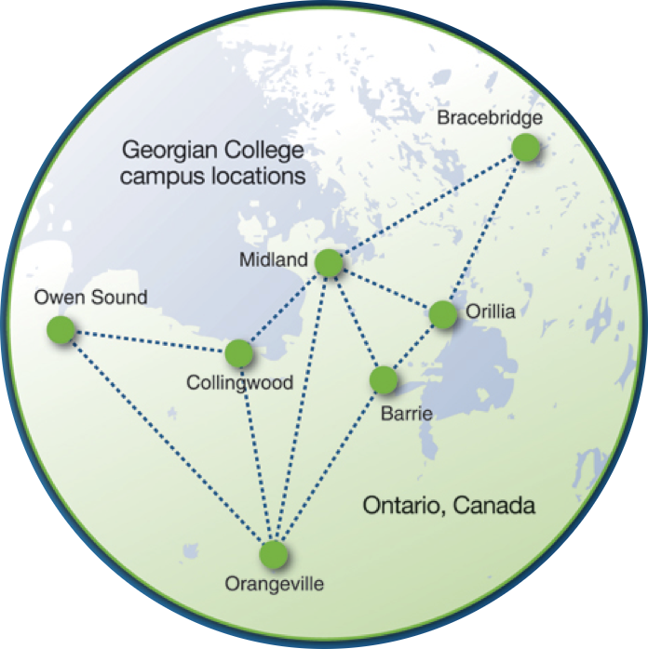
Georgian College
…is a mid-sized college consisting of a 10 site WAN in 7 cities located in central Ontario. Our IT infrastructure consists of over 7,500 network jacks, 230 virtualized servers, and over 3,300 managed computers.

Slide 24
Status of IPv6 implementation?
Georgian has completed a trial deployment but I feel we are still in the research stage.
We are participating in World IPv6 Day tomorrow, June 8th, 2011
For this we are dual stacking main www server, plus have a dedicated IPv6 only server
DNS server was dual stacked as well

Slide 25
Who is sponsoring/driving IPv6?
Information Technology, centralised department responsible for IT at Georgian
Have also involved the academic areas
In the end, predominantly me

Slide 26
IPv6-related concerns?
Proposing no NAT and no random generated addresses – worried about the perception of lack of security and lack of anonymity
Dual stacking some systems is a concern
Deploying security in a dual stack environment
Deciding what to do about tunnels
Training and vendor support now, before the issue is critical

Slide 27
IPv6-related technical issues … (cont.)
What traffic and miss-use are we missing on our networks while we don’t have a production IPv6 system and lan
Managing a new, second network with same limited resources – like the IPX, Appletalk days
Making the 2 networks integrate seamlessly for the end-user

Slide 28
IPv6 address space from ARIN?
Yes, obtained a /48 on March 18th , 2011
2620:dd::0/48
Georgian already had 5 class C IPv4 blocks and our own ASN.

Slide 29
Work done to-date? Issues still outstanding?
Completed so far :
IPv6 enabled at edge router with connection to ISP – ORION
Name server dual stacked and has IPv6 enabled
IPv6 only host, http://ipv6.georgianc.on.ca/ is set up

Slide 30
Work done to-date? Issues still outstanding? (Cont’d)
4. Main web server, http://www.georgianc.on.ca/ is dual stacked
Outstanding:
Production addressing scheme
IPv6 capability review in our firewalls and tool sets

Slide 31
Conclusion
Georgian has an active IPv6 Internet connection!
We are learning and trying to share our IPv6 knowledge inside our institute, and within our community
We are learning – I’m hearing a few “I didn’t know ….”
We are discussing this with colleagues
Our IPv6 environment is changing
It’s good, we’ve started early.

Slide 32
ACORN-NS

Slide 33
Why We Have to Get On With This
Our clients are using IPv6 whether we know it or not
Personal stats from home show 10%-20% IPv6
Windows 7 and others use automatic tunnels if we don’t provide native v6
“Hidden” performance issues (but not hidden from the end user)
How much are tunnels used?

Slide 34
6to4 from ACORN-NS March 2011 (thanks OTTIX and William Maton)
Notes:
3300 IPs out of 27,000 students, but IPs are reused
20 GB per day out of 1 TB over CANARIE

Slide 35
How we would like it to be

Slide 36
How it really is

Slide 37
IPv6 is not IPv4
It’s not just about laptops & servers
Over 500M cellphones manufactured each year
We shouldn’t try to blindly duplicate old practices
RFC4941 randomized addresses in Windows means we can’t force assignments -- forensics must switch from DHCP database to logs
Does everyone really have to be in DHCP?
Forget NAT and its illusion of security

Slide 38
How we as an ORAN can help
Get our own house in order – fully functional Gigapop and services
Training for ORAN and client support staff
Awareness of issues so implementation can get the proper priority
Assistance during implementation
Local 6to4 relay during transition

Slide 39
Hard & Easy
Easy parts
Routing
Standard services (web, email, ntp, DNS, etc)
Hard parts
People

Slide 40
York University

Slide 41
CIO check
No apparent end-user impacts to-date
Take IT resource-conscious approach
Capability survey
Gap analysis
Look for a business case
Assessment of IPv6 requirements/readiness is part of FY2011-12 IT work plan .

Slide 42
Drivers for IPv6
Growth in IP address space consumption
Mostly due to WLAN growth (30% year-over-year growth of concurrent WLAN end-points)
NAT is not favoured
operationally troublesome for IT
interferes with some applications

Slide 43
IT infrastructure check
Require IPv6 support in network-related technology acquisitions since 2008
Router, Access Switch, FW, IPS, IPAM, WLAN
Tracking IPv6 enabled applications and technologies
Windows 7 DirectAccess .

Slide 44
Audience contributions
What do you see as the most potent drivers for change in your organization?
What is your plan for IPv6 deployment?
What was the easiest thing to get right?
What was the hardest thing to get right? .

Slide 45

Thank You!

